Slide 1
Graph Group Linking Household Graph
US Census Bureau Research Project

Slide 2
Objective
The main objective of this project is to find the hidden links between the pair of name and addresses.
Also this refers to as Household Graph
For an instance if we have the data as
John Doe and Mary Doe in Oak Street, and We have same name in other address like Pine Street.
So we can say that John Doe and Mary Doe are the same persons which has different addresses.

Slide 3
Proposed System
We have designed a system in which we use python program to either way generate Links between the Groups.
We uses python library (pyvis) to link the groups and uses some traversing techniques to find the matchings.

Slide 4
Step-1: - Use of Name & Address Parser
Address Parsing: -Extract the name tokens and the address tokens to create two new files using the same record IDs (Using the address Parser)
Now we have to Create File_A with 2 items, the RecID and the address tokens; For example, if File A has the record "A123, John Doe, 123 Oak St, Little Rock, AR 72212"
Then in File_A would be "A123|123 OAK ST LITTLE ROCK AR 72212" using a pipe delimiter
Create File_N with 2 items, the RecID and the name tokens

Slide 5
Step-3 Use of Data Washing Machine
Now Run the File_A address records through the data washing machine to cluster the same addresses Append the DWM cluster IDs back to both File_S and File_N
Suppose the Address record "A123|123 OAK ST LITTLE ROCK AR 72212" is assigned to address cluster "T56" by the DWM
Then we append "T56" to the original record in File_S giving us "T56, A123, John Doe, 123 Oak St, Little Rock, AR 72212"
Then we also append "T56" to the corresponding record in File_N giving us 3 items "A123|JOHN DOE|T56"

Slide 6
Step-3 Sorting and Appending
The next step is to append the clusters to the Name File and then split the names and sort it
Next, we process File_N to output blocking records into new File_B
The records in File_B have 2 items, the address cluster ID and one name token
"T56|JOHN"
"T56|DOE“
Next we sort the records in File_B by the name token

Slide 7
Step-4 Deduplicating, traversing and Querying
Sort the pari file File_P and remove duplicate pairs
Load File_S with the appended address IDs in to the graph to create record nodes labeled with the RecID connected to Address nodes labeled with the Address ID
Load the deduplicated File_P to generate edges between the address nodes.
Write a query to visit all of the connected address nodes and determine if the addresses share at least two of the same names.

Slide 8
Example -1
Example of the process with 10 records
File_S
R01, Mary Doe, 123 Oak St
R02, John Doe, 123 Oak St
R03, John Doe, 456 Elm St
R04, Becky Smith, 456 Elm St
R05, Mary Doe, 110 Main Street
R06, John Doe, 100 Main Street
R07, William Jones, 921 Rose Ave
R08, Susan Jones, 921 Rose Ave
R09, Bill Jones, 679 Pine
R10, Sue Jones, 679 Pine

Slide 9
File_A after Clustering and generating Address ID
R01| 123 OAK ST
R02| 123 OAK ST
R03| 456 ELM ST
R04| 456 ELM ST
R05| 110 MAIN STREET
R06| 110 MAIN STREET
R07| 921 ROSE AVE
R08| 921 ROSE AVE
R09| 679 PINE
R10| 679 PINE

Slide 10
File_A after Clustering and generating Address ID
R01| 123 OAK ST|R01
R02| 123 OAK ST|R01
R03| 456 ELM ST|R02
R04| 456 ELM ST|R02
R05| 110 MAIN STREET|R03
R06| 110 MAIN STREET|R03
R07| 921 ROSE AVE|R04
R08| 921 ROSE AVE|R04
R09| 679 PINE|R05
R10| 679 PINE|R05
Note:- R01 etc are considered as cluster ID’s and replaced with C1 etc.. For less confusion from next slide

Slide 11
File_S+ after appending Address ID
C1, R01, Mary Doe, 123 Oak St
C1, R02, John Doe, 123 Oak St
C2, R03, John Doe, 456 Elm St
C2, R04, Becky Smith, 456 Elm St
C3, R05, Mary Doe, 110 Main Street
C3, R06, John Doe, 100 Main Street
C4, R07, William Jones, 921 Rose Ave
C4, R08, Susan Jones, 921 Rose Ave
C5, R09, Bill Jones, 679 Pine
C5, R10, Sue Jones, 679 Pine

Slide 12
File_N after appending Address ID
R01| MARY DOE| C1
R02| JOHN DOE| C1
R03| JOHN DOE| C2
R04| BECKY SMITH| C2
R05| MARY DOE| C3
R06| JOHN DOE| C3
R07| WILLIAM JONES| C4
R08| SUSAN JONES| C4
R09| BILL JONES| C5
R10| SUE JONES| C5

Slide 13
Splitting the Names
File_B generated from File_N
C1| MARY
C1| DOE
C1| JOHN
C1| DOE
C2| JOHN
C2| DOE
C2| BECKY

Slide 14
Sort it, Deduplicate it
After sorting and deduplicating pairs
C1, C2
C1, C3
C2, C3
C4, C5

Slide 15
R2
R3
R1
C2
C1
R4
R9
R5
C3
R7
C4
C4
R6
R8
R10

Slide 16
After we find the Links
R2
R3
R1
C2
C1
R4
R9
R5
C3
R7
C4
C5
R6
R8
R10

Slide 17
After Traversing and Querying
R2
R3
R1
C2
C1
R4
R9
R7
R5
C3
C5
C4
R6
R8
R10

Slide 18
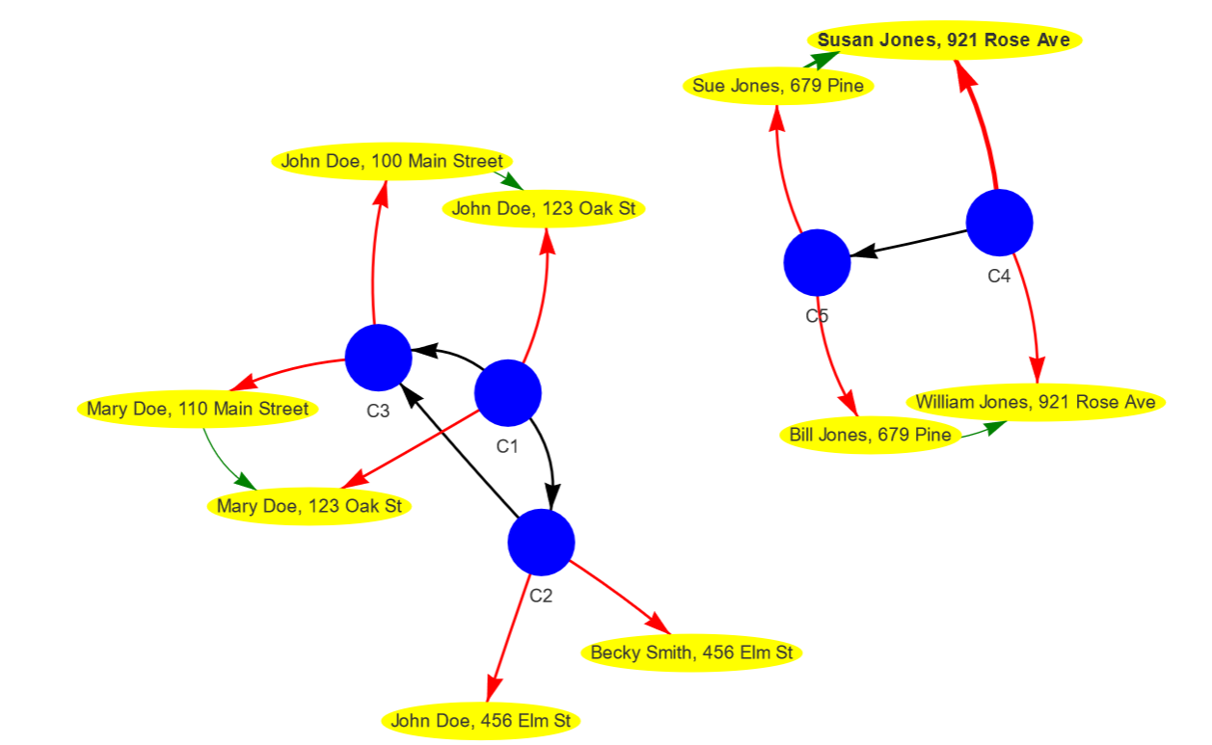
Similar Output From Python Program

